Slide 1
Measurement Techniques
Melissa N. Horger
What are you measuring?
How are you measuring it?

Slide 2
Teaching measurement in an upper level Experimental Psychology course
Goals:
Teach students how to operationalize psychological concepts (e.g. communication, cognition, emotion, etc.)
Highlight different kinds of measurement (e.g. frequency count, timed variables, qualitative descriptions, etc.)
Discuss the conclusions that can be drawn based on each kind of measurement
Lesson Plan:
Students watch a brief video of chimps and code for behaviors outlined on distributed coding sheets. Data is collected and reviewed.

Slide 3
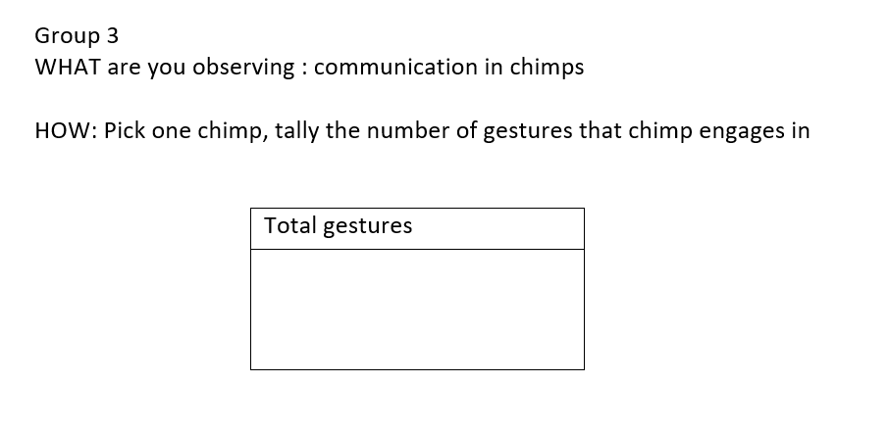
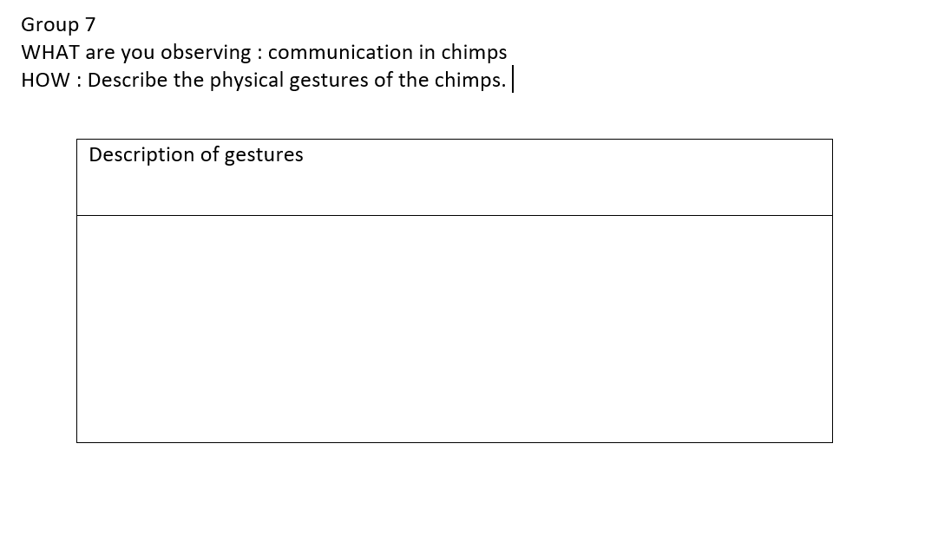
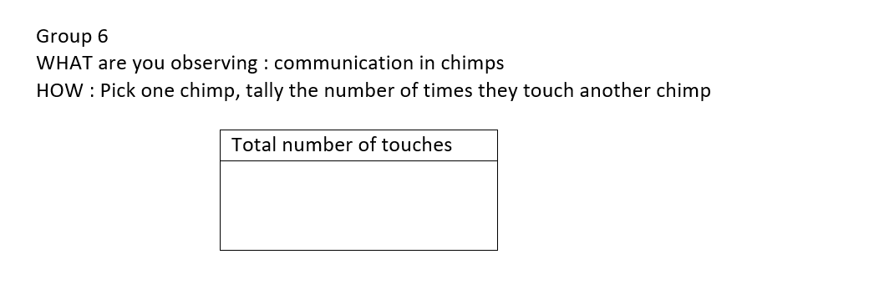
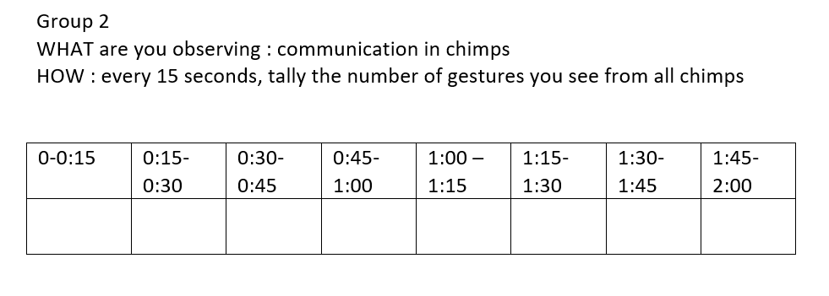
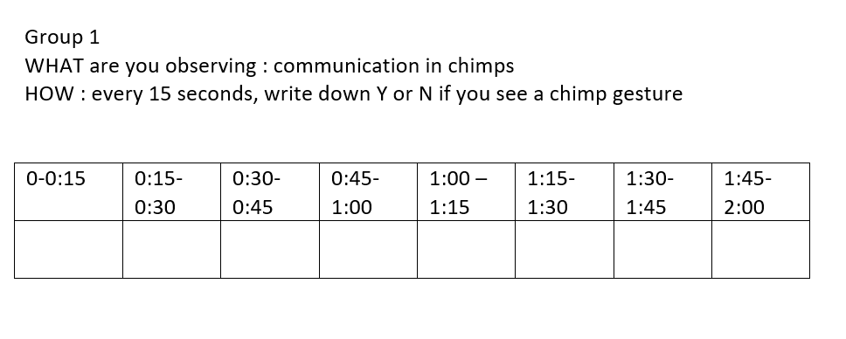
Coding sheets

Slide 4
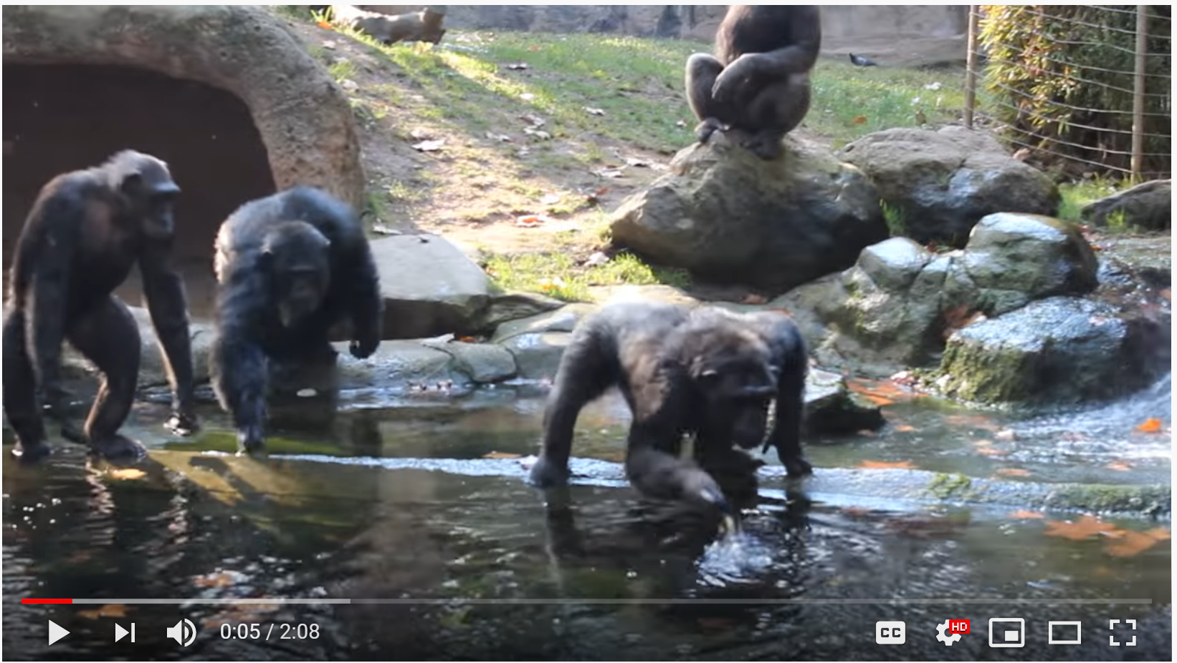
Behaviors in coding sheets
The resulting data includes examples of:
Binary data
Frequency counts
Timed sampling
Group vs. individual observations
Qualitative descriptions

Slide 5
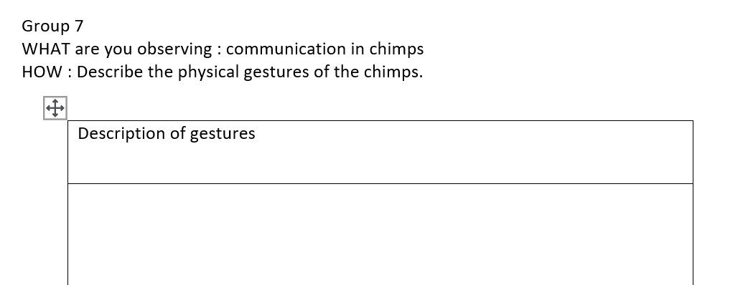
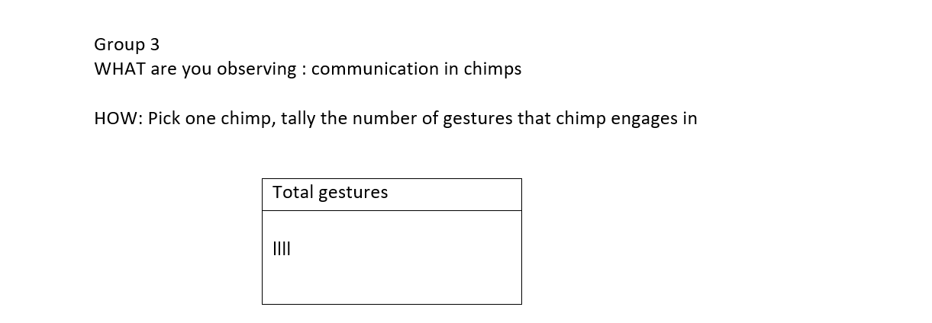
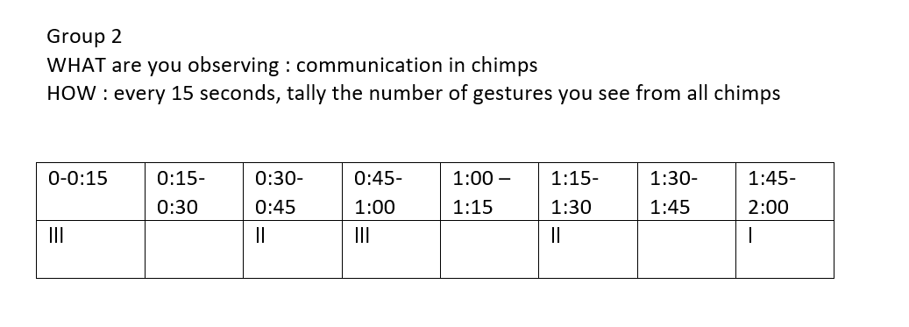
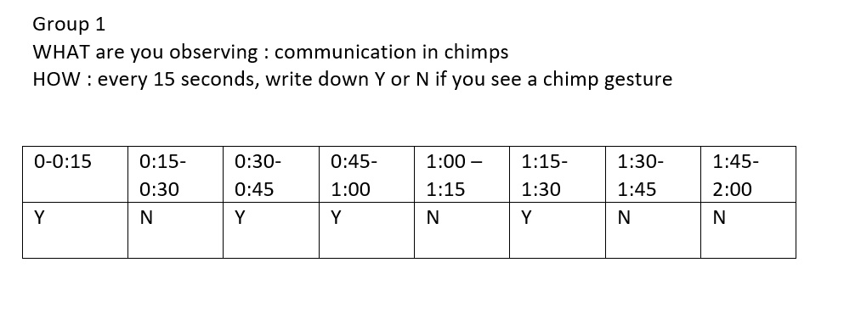
Discussion
Display the different kinds of data each group collected.
Other topics
Operational definitions
Interrater reliability
Coding sheets are designed to build off each other within an operationalized behavior.

